Slide 1

Web Development Projects
CREATED BY: Mohd Adnan

Slide 2
Project Objectives
UNDERSTANDING THE PURPOSE OF EACH PROJECT
The Simple Calculator aims to facilitate basic arithmetic operations with ease. The Personal Webpage serves as a digital portfolio, showcasing individual profiles.

Slide 3
Technologies Utilized
This table summarizes the core technologies applied in each project, showcasing foundational skills essential for web development.
PROJECT | TECHNOLOGIES USED
Simple Calculator | HTML, CSS, JavaScript
Personal Webpage | HTML, CSS, Responsive Design
Both Projects | Basic Web Development Skills

Slide 4

Key Features
FEATURES OF THE SIMPLE CALCULATOR
Includes arithmetic operations like addition and subtraction, a clear function, error handling, and a user-friendly interface for functionality.
FEATURES OF THE PERSONAL WEBPAGE
Showcases a profile picture, bio, social media links, and a neatly designed footer. It enhances personalization and modern presentation online.

Slide 5
Code Overview
SIMPLE CALCULATOR CODE INSIGHTS
PERSONAL WEBPAGE CODE INSIGHTS
COMPARISON OF CODE STRUCTURES
HTML structure with number buttons and display. CSS for styles, and JavaScript handles user interactions and calculations.
HTML layout for profile information. CSS for styling and mobile responsiveness, enhancing user engagement.
Both projects utilize similar technologies, showcasing different applications in creating functional and aesthetic web pages.

Slide 6
Project Outcomes
RESULTS FOR USERS
Users gain a simple, fully functional calculator for everyday use and a modern personal webpage to enhance online presence and branding.

Slide 7
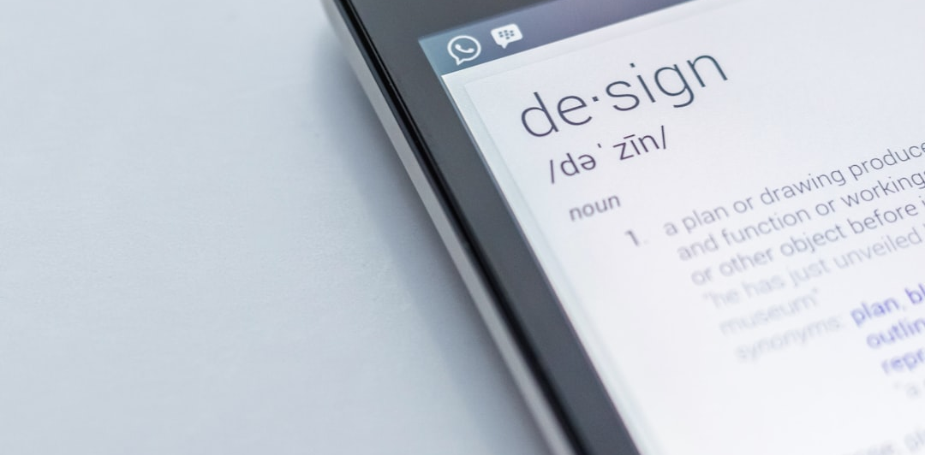
Future Improvements
ENHANCEMENTS FOR THE CALCULATOR
Potential features could include advanced calculations, history tracking of calculations, and a scientific mode for additional functionality.
ENHANCEMENTS FOR THE PERSONAL WEBPAGE
Adding sections for skills, projects, and contact information could enhance user engagement and provide a more comprehensive professional portfolio.

